Slide 1
Capstone Project - The Battle of Neighborhoods
A study for a pizza chain
Project made for peer graded assignment for the Course “Applied Data Science Capstone” By Utkarsh Sharma

Slide 2
INTRODUCTION / BUSINESS REQUIREMENT
An international Pizza Chain wants to setup their Pizza Store in Canada and they have shortlisted Toronto for their first store because Toronto is the largest city in Canda and is quite densely populated. Added advantage is to of historical monuments and frequent tourist footfall.
The Pizza Chain wants us to decide their store location.
They want us to analyse feasibility of location of store with respect to the neighbouring store in the region. They want to minimize competitors.
They want to open the store either in the main Toronto or Either in Scarborough Location(formerly called East Toronto).

Slide 3
DATA
In order to carry out this project we will be needing data from a few sources including wikipedia, Foursquare and CSV files. All the sources of data and their specifications are described below:
Wikipedia Source: We need the information of Boroughs and Neighbourhoods from the wikipedia Website. Wikipedia has a well defined table of all the details of neighbourhoods required to make the analysis of this project.
Foursquare API: Foursquare API will have major role in this project as this API countains all the neighbourhood details. This is a regularly updated database of the neighbourhoods. We have choosen this API because firstly it is mandated to use it, secondly it is free of cost and it provides enough calls per day to make this project feasible. The data obtained from this website is properly formatted leaving no hustle to format it. It's very itntuitive.
Geospatial Coordinates CSV File: This File has all the latitudes and longitudes stored for all the required postal codes of Canada.

Slide 4
METHODOLOGY
The approach to achieve this work was fundamentally the following:
Getting the data
Cleaning and preparing the data sets
Create Machine learning Clusters
Check the totals for both cities.
Compare the two cities’s suitability for pizza store on the basis of totals.

Slide 5
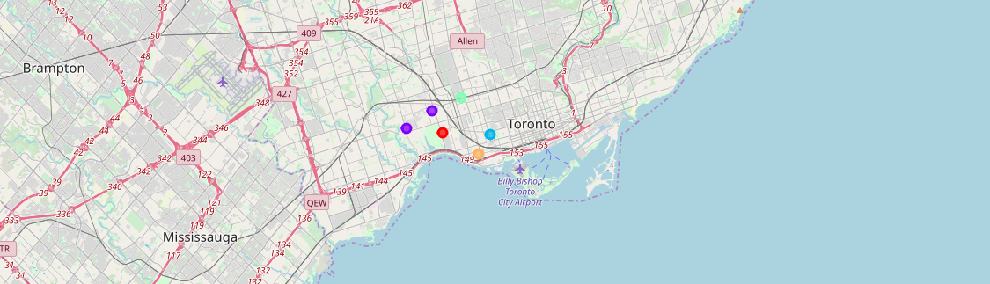
CLUSTERING ON TORONTO

Slide 6
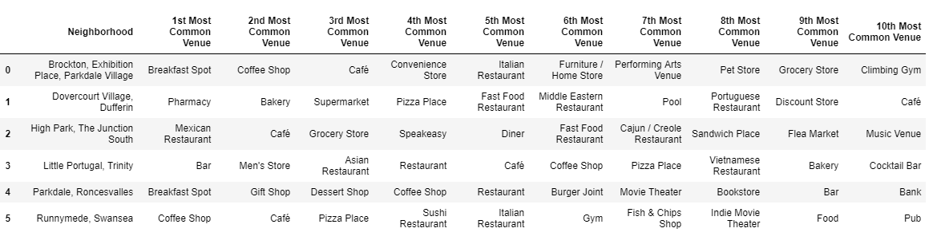
STATISTICS FOR TORONTO

Slide 7
STATISTICS FOR TORONTO
Venue Category | Venue
Bar | 13
Café | 11
Coffee Shop | 10
Italian Restaurant | 6
Pizza Place | 6
Bakery | 5
Men's Store | 4
Breakfast Spot | 4
Restaurant | 4
Pharmacy | 3

Slide 8
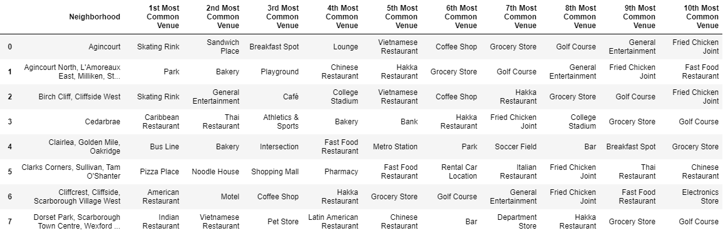
STATISTICS FOR SCARBOROUGH

Slide 9
STATISTICS FOR SCARBOROUGH
Venue Category | Venue
Bakery | 5
Fast Food Restaurant | 5
Coffee Shop | 4
Pizza Place | 4
Breakfast Spot | 4
Chinese Restaurant | 4
Sandwich Place | 2
Pharmacy | 2
Fried Chicken Joint | 2
Playground | 2

Slide 10
RESULTS
The 1st Common venue for Toronto are Breakfast, Pharmacy, Mexican Restaurant, Bars and Coffee Shops.
The 1st Common venue for Scarborough are Skating Rink, Park, Caribbean Restaurant, Bus line, pizza place, american restaurant indian restaurant etc.
Pizza Place count is 6 in Toronto.
Pizza place count is 4 in Scarborough.
Highest venue count is 13 in toronto.
Highest venue count is 5 in Scarborough.

Slide 11
DISSCUSSION
We can clearly see that Highest venue count in toronto is 13 where as in scarborough is 5 there for on the basis of 1st common venue algorithm it would be unfair to give clear advantage to Toronto for Pizza place because any pizza place will not occur in 1st common venue due to presence of other stores in higher count. So our dicussion now moves straightaway to the Pizza Place counts. The decision should be taken on the pizza place counts in individual regions. We can see that total Pizza place in Toronto is 6 whereas in Scarborough it is 4. It would be an advantage to set Pizza place in Scarborough clearly.

Slide 12
CONCLUSION
The best solution is to open the Pizza Place in Scarborough because there are less competitors and Pizza places are 1st most common visiting places in Scarborough.

Slide 13
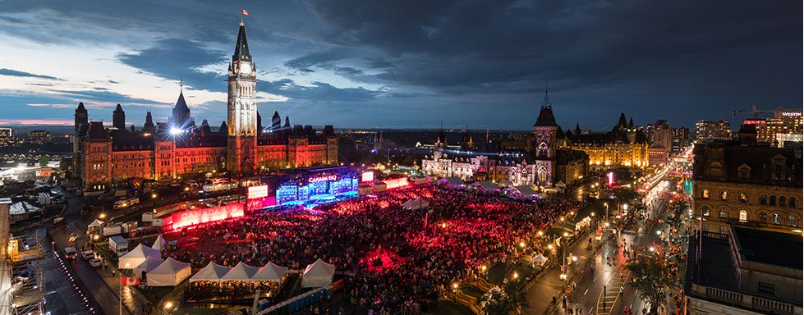
Thank you

